Slide 1
T-06 Intercom
By
Lionel Diaz
Noah Harvey
Tyler Seitz
Binh Phan Matthew Walters

Slide 2
Motivation
Family
Challenge
Most Interesting Project

Slide 3
Problem
Buildings without communication
Interoffice communication
Apartment building communication
Communication between families
Notes:
Matt

Slide 4
Objective
A device that allows people to talk with each other
A device should be modular to allow for ease of repair and user setup.
User interface should be clear and straightforward

Slide 5
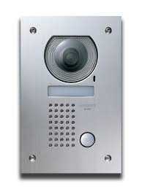
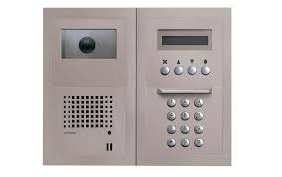
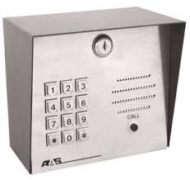
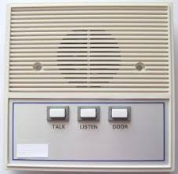
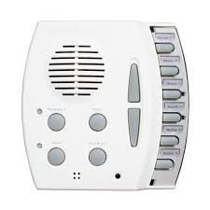
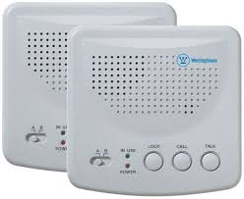
Alternatives

Slide 6
Requirements:
Easy to use and self-operated
Interactive feedback mechanism to determine when a button's pressed
Communicate to a single device
Provide clear voice-band data transfer

Slide 7
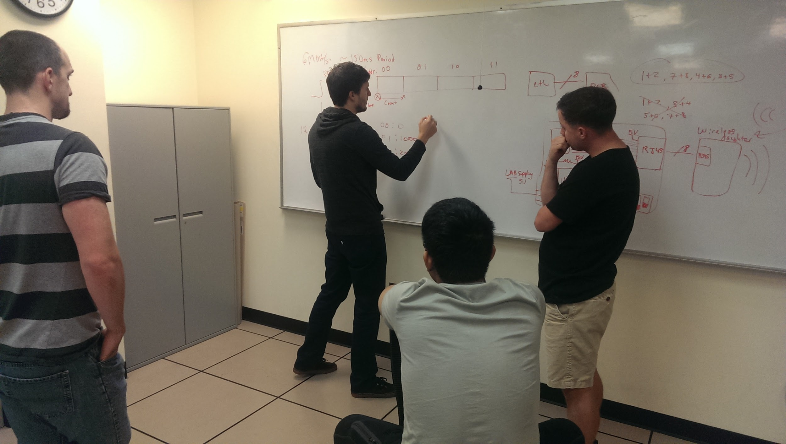
Approach
Research! Research! Research!
There are 4 phases of this project:
Design
Implementation
Testing
Evaluation
Project Schedule Plan
Phase | Duration (Weeks)
Design | 2
Implementation | 5
Testing | 2
Evaluation | 1

Slide 8
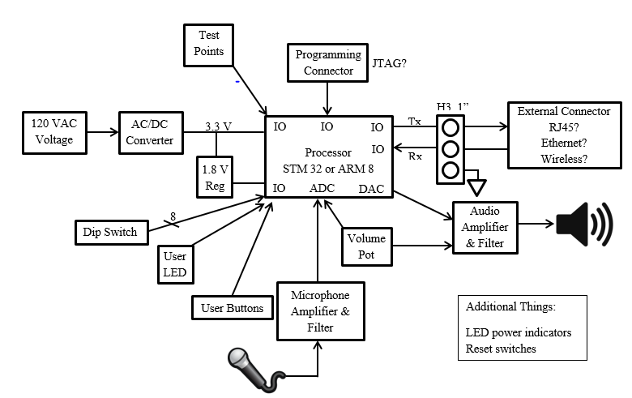
Approach Continued...
Initial Block Diagram

Slide 9
Approach Continued...
Assigned Modules
Module | Team Members
Design | Everyone
Documentation | Everyone
Code | Noah, Matt, Tyler
Schematic | Leo, Tyler
Layout | Tyler

Slide 10
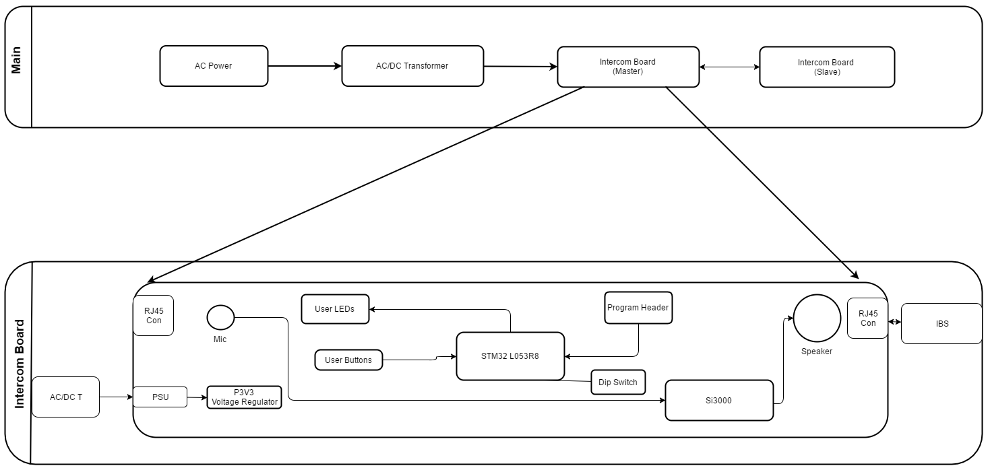
Hardware Flow Diagram

Slide 11
Design
What kind of microcontroller / processor to use?
Use an audio codec or build from scratch?
How many units or buttons?
Extras?

Slide 12
Design Continued...
Microcontroller | STM32L053R8T6 | High enough clock frequency, less expensive
Audio Codec | Si3000 | Less expensive, package size and simplicity of configuration
Protocol | SPI | Get more transferred data

Slide 13
Design Continued…
Microcontroller: STM32L053R8
STM32L053R8T6 in LQFP64 package
ARM®32-bit Cortex®-M0+ CPU
32 MHz max CPU frequency
VDD from 1.65 V to 3.6 V
64 KB Flash
8 KB SRAM
GPIO (51) with external interrupt capability
12-bit ADC with 16 channels
12-bit DAC with 1 channel
RTC
Timers (5)
I2C/I2S (2)
USART (3)
SPI (2)
USB 2.0 full-speed
Notes:
We used this because Tyler is familiar with this microcontroller

Slide 14
Design Continued…
Audio Codec: Si3000
84 dB ADC Dynamic Range
84 dB DAC Dynamic Range
4–12 kHz Sample Rates
Up To 30 dB Microphone Pre-Amp
Programmable Digital Input Gain/ Attenuation: –34.5 dB to 12 dB
Programmable Digital Output Gain/ Attenuation: –34.5 dB to 12 dB
Support for 32Ω speaker
3:1 Analog Input Mixer
3.3–5.0 V Power Supply
FIR and IIR Filter (50Hz-4kHz pass band)
Direct Serial Interface to DSPs Direct Connection to Si303x/44/56, serial interface DAA chipsets

Slide 15
Design Continued…
Protocol: SPI
Full Duplex Capability
Asynchronous / Synchronous
3 - 16 Bit Data Width
4 SPI Operating Modes
Continuous Data Stream
High Speed (We used 8MHz)
Notes:
We chose to use SPI because of the high data transfer rates, its ability to stream data continuously instead of data packets and if we had time make the system full duplex.

Slide 16
Implementation
Details of Implementation
Major Components
Schematics
Board Layout
Code

Slide 17
Implementation Continued...
Details of Implementation
Major Components
Processor
Audio Codec
Buttons
LEDs
Switches
Line Driver (Single-ended to LVDS Transceiver)
RJ45 Connector
Programming Connector

Slide 18
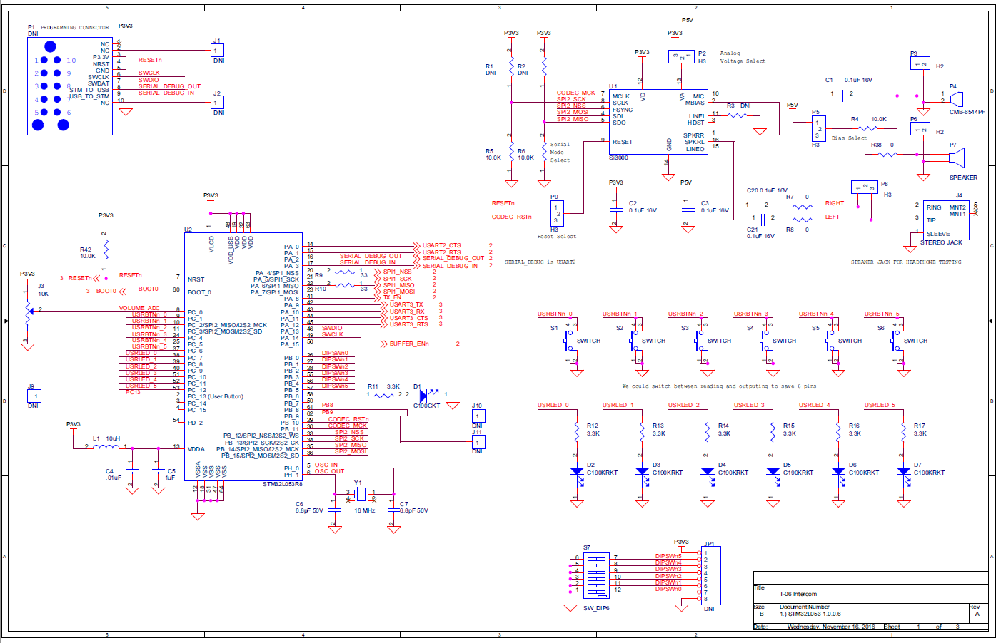
Implementation Continued...
Details of Implementation
Schematics

Slide 19
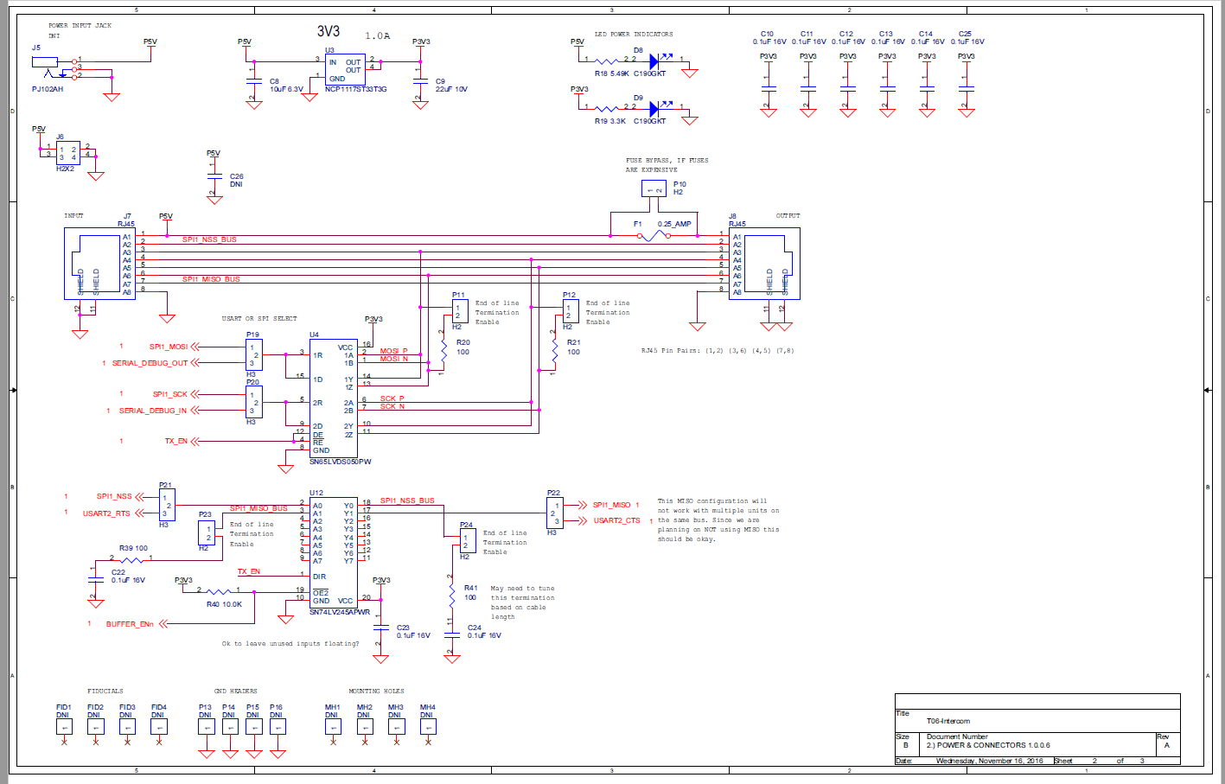
Implementation Continued...
Details of Implementation
Schematics

Slide 20
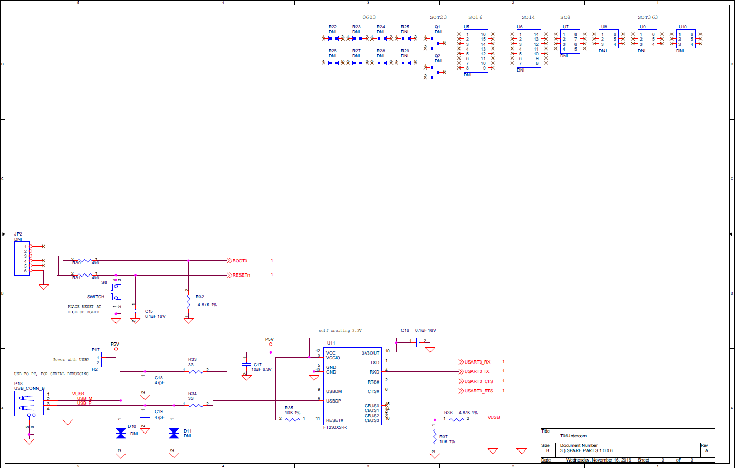
Implementation Continued...
Details of Implementation
Schematics

Slide 21
Board Layout
Dimensions: 4.9” x 4.0”
Top/Bot , Horz./Vert. Routing
Primarily SMT parts
Debugging & Configuration Headers
Silkscreen Labeling
PDF of board gerbers found here.

Slide 22
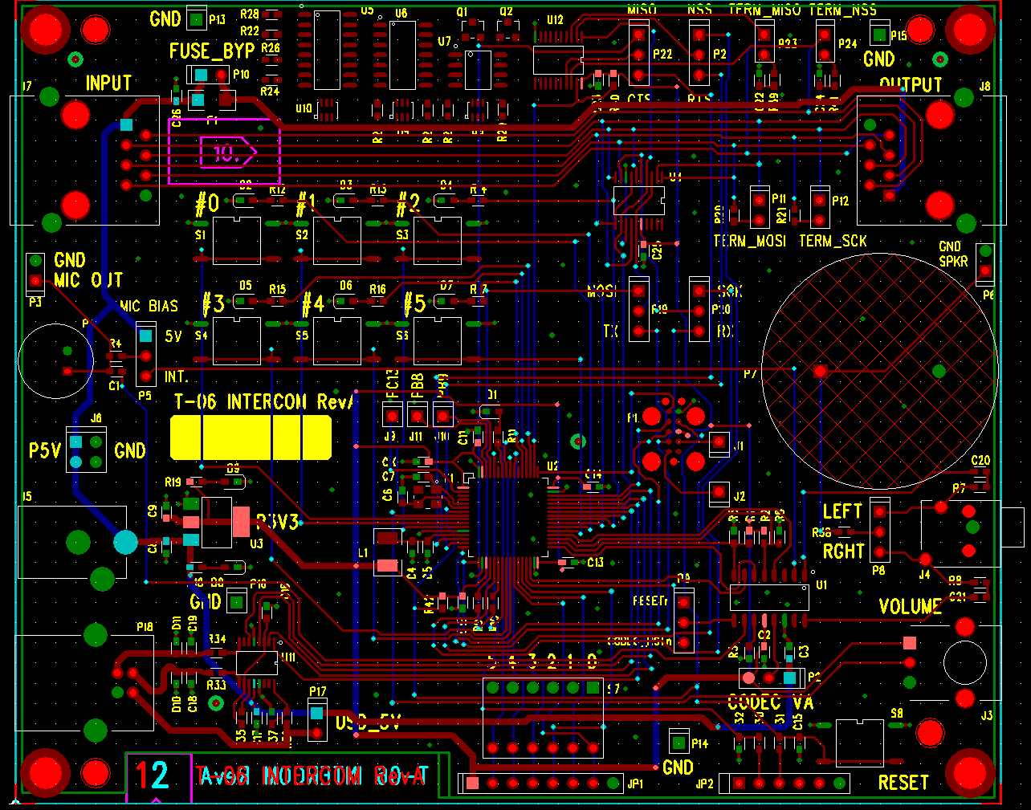
Board Outline

Slide 23
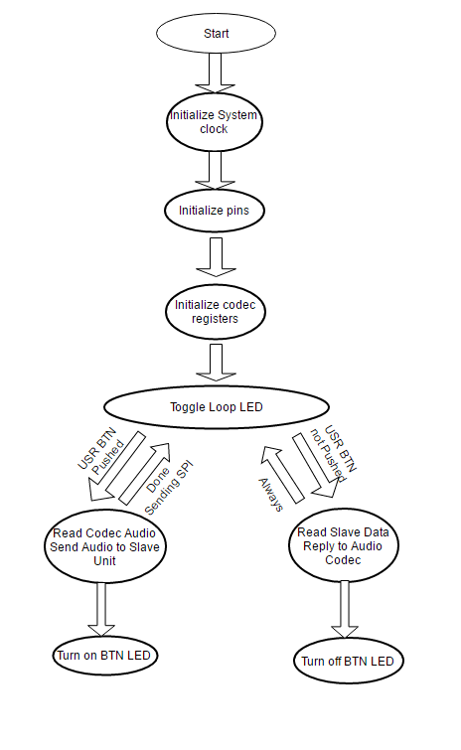
State Diagram

Slide 24
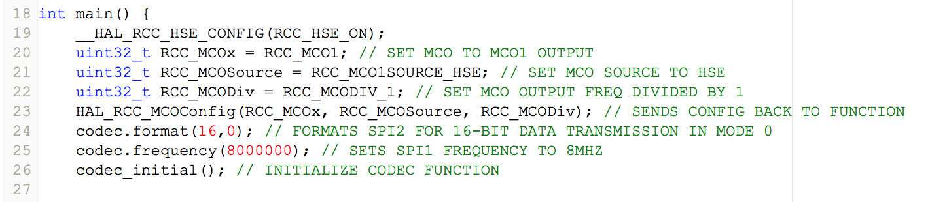
Implementation Continued...
Details of Implementation: Code Excerpt
...

Slide 25
Implementation Continued...
Tools Employed:
MBED Online IDE
Cadence OrCAD Schematic Capture
Personal Automation Design Solutions (PADS) By Mentor Graphics
PCB Unlimited (Board House)
Notes:
OrCAD for schematic
PADS for layout
MBED for IDE and compiler
PCB Unlimited for PCB fabrication

Slide 26
Bill of Materials
Item | Quantity | Line Cost* | Part | PCB Footprint
_____________________________________________________________________________
16 | 1 | $3.53 | SPEAKER | SPKR-AST-030C0MR-R
25 | 1 | $2.29 | Si3000 | SO16NB
26 | 1 | $4.51 | STM32L053R8 | QFP64-0.5
. . .
PARTS |  | $29.22
PCB |  | $18.00
TOTAL PER UNIT: |  | $47.22
 | *Costs based on build of 10 units.
Full BOM located here.

Slide 27
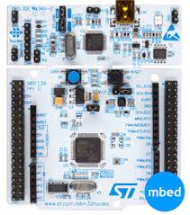
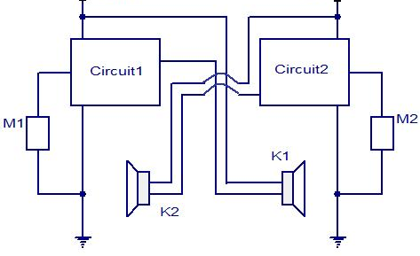
IP and Prior Work
Development Environment Nucleo:
Utilized:
Online Compiler
Online Support & Forums
Example Programs & Database
Datasheets:
Audio Codec Si3000
STM32 L053R8
Voltage Regulator (NCP1117ST3)
Microphone Receiver (CMB-6544PF)
Speaker (AST-303C0MR-R)
Differential line driver(SN65LVDS050)
Octal Bus Transceiver(SN74LV245)

Slide 28
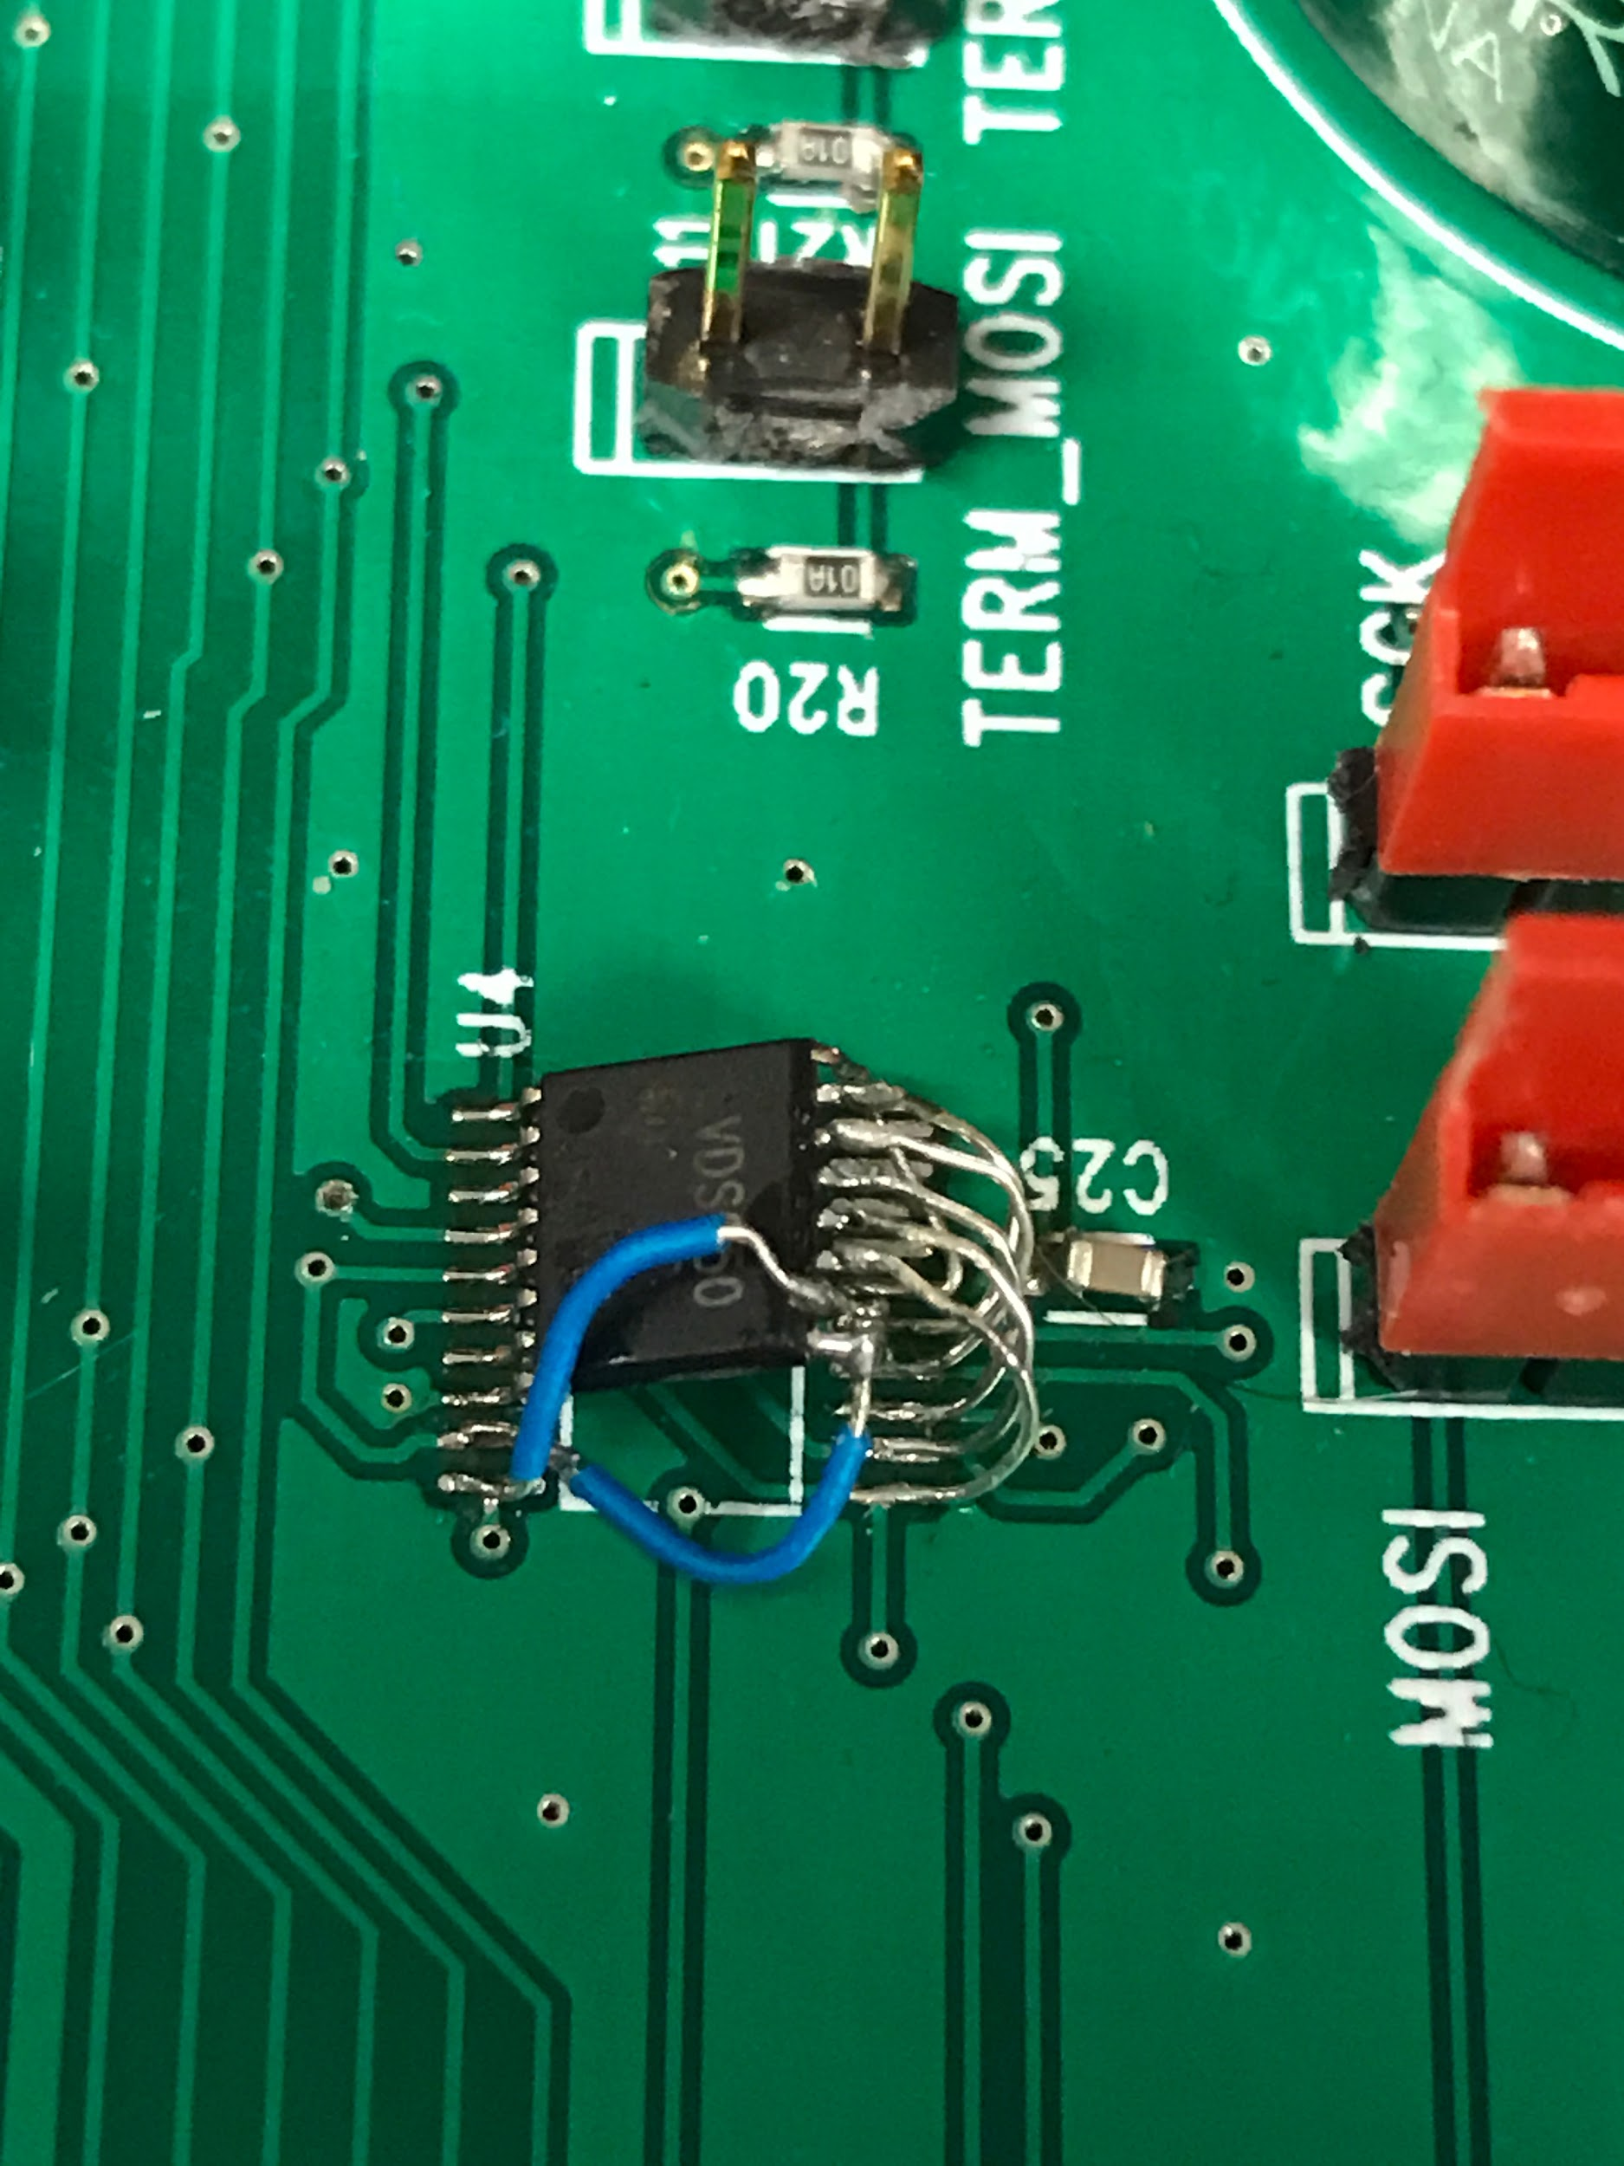
Turning on Boards - Mods
Swap pins 63 and 64 on the processor
Add 10K pullup to NSS on SPI Bus
TSSOP16 package designed with TSSOP20 decal
Increase capacitance on 3.3V
Swap SDO and SDI pins on the audio codec
Increase series speaker capacitance

Slide 29
Testing
Functional Checks
Power supply
User buttons
Microphone and speaker
Volume control knob
Integration Test
Si3000 Audio Codec
STM32L053R8 Microprocessor
SPI Bus Data Communication

Slide 30
Results
What worked?
Two-way Communication
Buttons
LEDs
How well?
SPI S-Clock Data Duplication Errors
What didn’t work?
ADC (Volume Control)
SPI Master to Slave Configuration Changes
Why?
Programming Issues & Time

Slide 31
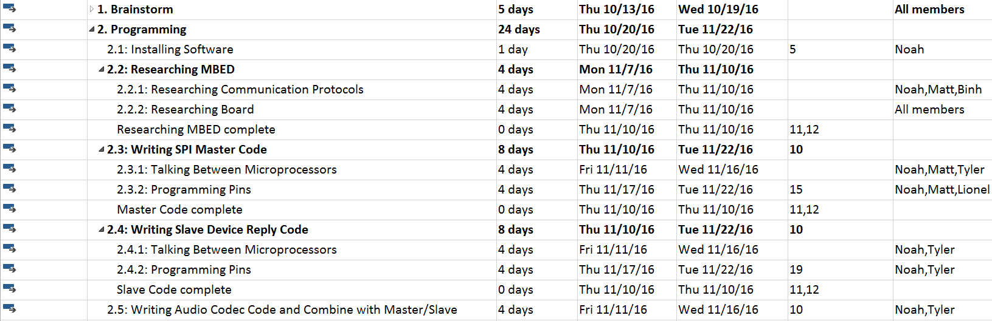
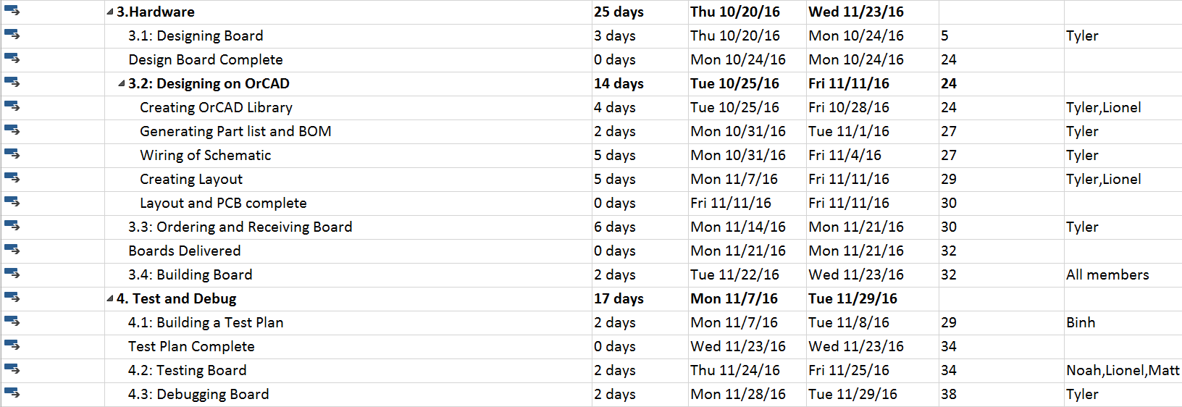
Contributions

Slide 32
Lessons Learned
Time Management
Sub-Divide Work More Efficiently
More Time Reviewing Designs
Leave Time For Board Revision
Choose Project Wisely
Base on strengths

Slide 33
Questions?

